Slide 1
The 12 lead ecg in st elevation myocardial infarction
Dr Sanjay
Senior Resident
Dept of Cardiology
GMC, Kozhikode

Slide 5
The heart walls and their segmentation

Slide 6
Posterior wall: basal part of IP wall branches upward and then becomes really posterior
The North American Societies of Imaging divides the LV into 17 seg. and 4 walls.

Slide 7
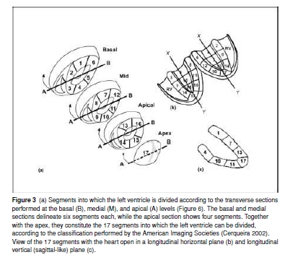
Consensus states IP wall should be called inferior
for consistency and seg 4 inferobasal instead of posterior

Slide 9
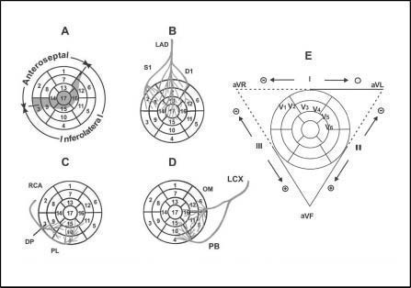

Slide 10
Coronary circulation: perfusion of the heart walls

Slide 11
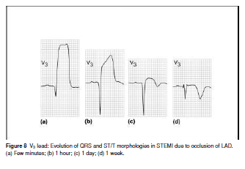
The ecg chnges in stemi
After the complete occlusion, the ischemia occurs first in the subendocardium producing a taller T wave
The ischemia soon becomes transmural and homogeneous (ST elevation)
With persistent occlusion of an epicardial coronary artery the ST elevation evolves from an initial concave upward to a convex upward pattern.
This is usually followed by a Q wave of necrosis and an inverted T wave

Slide 12
Current of injury
Deviation of the ST segment –earliest and most consistent ECG finding during acute severe ischemia
Acute ischemia – reduction in resting membrane potential, duration of action potential and rate of rise and amplitude of phase 0 in the ischemic area

Slide 16
Infarction size
Amount of ST segment elevation and ST depression
Number of leads in which these changes are present

Slide 17
The concept of injury vector: direct & reciprocal changes
In STEMI ST-segment depression-recorded in leads registering electrical signals from walls of the heart opposite to the area at risk (reciprocal patterns)
Identifying the culprit coronary artery -injury vector oriented towards the injured area generates ST-segment elevation in the leads facing the vector’s head and ST-segment depression in the leads facing the vector’s tail (opposed leads)

Slide 18
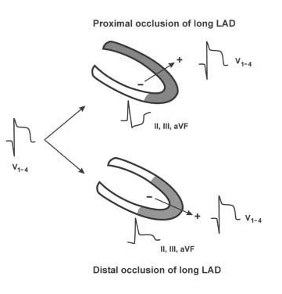

Slide 20
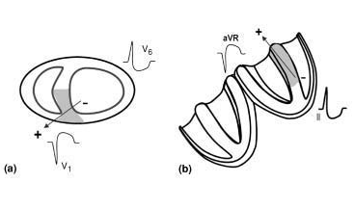

Slide 21
ST-segment changes in reciprocal leads permits one to determine
whether the occlusion located in the LAD is proximal or distal to the first diagonal branch
whether the occlusion is located in the RCA or in the LCX
whether the occlusion is proximal or distal to the first septal branch (S1)

Slide 22
Clinical interpretation and significance of st changes
How to identify the area at risk and the corresponding ECG based on the location of the occluded artery
How one can identify the area at risk and the occlusion site based on the ECG findings

Slide 23
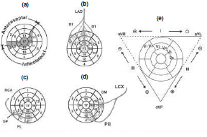
From the occluded artery to the area at risk and the corresponding ecg abnormality
LV divided into two zones:
Anteroseptal zone : occlusion of LAD and its branches
Inferolateral zone : occlusion of RCA and LCX

Slide 24
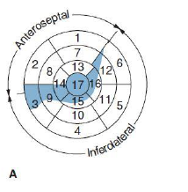
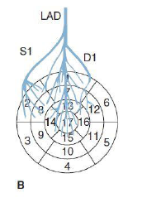
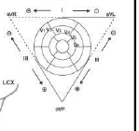

Slide 26
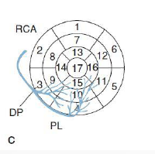

Slide 27
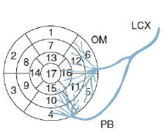

Slide 28
Anteroseptal zone: occlusion of lad and its branches
above D1 and S1
above the D1 branch but distal to the S1 branch
below both the S1 and D1 branches
above the S1 branch but distal to the D1 branch
LAD occlusion including the diagonal branches but not the septal branches or just a selective D1–D2 occlusion
LAD occlusion involving the septal branches but not the diagonal branches or rarely a selective S1–S2 occlusion

Slide 29
Occlusion above D1 & S1 branches

Slide 30
Area at risk is large
Lead to an extensive anterior infarction
Injury vector
- anteriorly and upward
- somewhat to the right or the left, depending on whether septal – the most frequent – or lateral involvement predominates

Slide 31
ST elevation in V1 to V4 and aVR
Anterolateral predominant – ST elevation also seen in aVL and I

Slide 32
Proximal lad occlusion
ST-segment depression in the inferior wall (III + aVF ≥ 2.5 mm) is quite suggestive of a proximal occlusion of LAD above D1
ST-segment depression in V6 with ST-segment elevation in aVR and V1 is quite specific for occlusion above the S1 branch
(ST↑ VR and V1 + ST↓ V6 > 0)

Slide 34
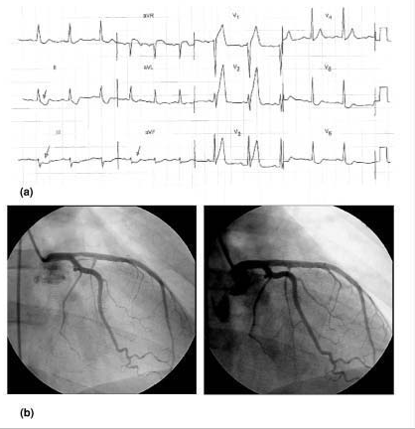

Slide 35
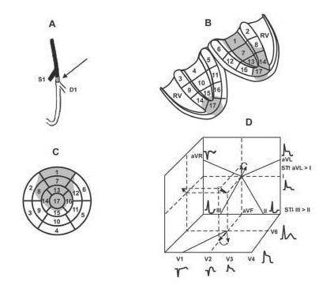
Occlusion proximal to d1 but distal to s1

Slide 36
Area at risk – anterior infarction with mid low part of septal and lateral anterior walls
Upper anterior part of lateral wall is perfused by LCX
When S1 is small, area of septal wall involved will be larger

Slide 37
Injury vector – forward, upward and to the left
ST elevation from V2-3 to V5-6 and I and aVL but not usually in V1
ST-segment depression in the inferior leads (III+aVF≥2.5mm)
Usually, more ST-segment depression is seen in III than in II, since lead III is opposed to aVL

Slide 38
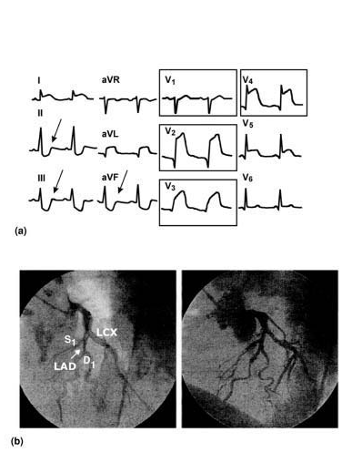

Slide 39
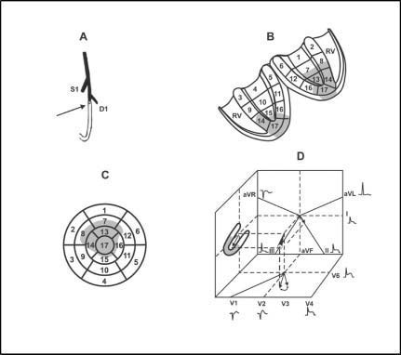
Occlusion distal to s1 and d1

Slide 40
Area at risk - inferior third of the left ventricle, with almost invariably some inferior involvement and only low-lateral involvement (apical infarction)
Injury vector - anteriorly and to the left (to the apex), but not upward.
When the LAD is long, it may perfuse a large portion of the inferior wall

Slide 41
ST segment elevation fromV2−3 toV4−6 but not inV1 and/or aVR
Due to downward direction of this vector there is usually slight ST-segment depression in aVR and elevation in II, III, and VF (II > III)

Slide 42
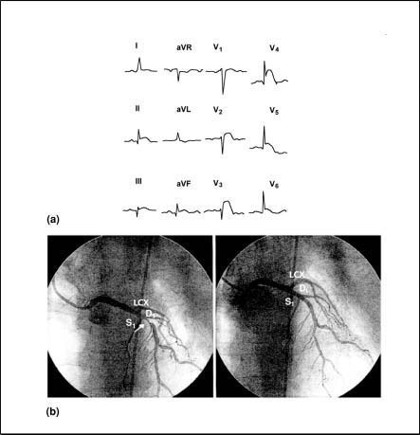

Slide 43
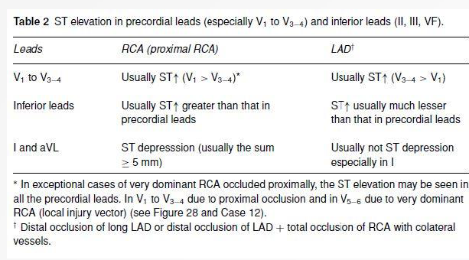
ST-segment elevation is also seen in the precordial and inferior leads in the presence of a STEMI due to the very proximal occlusion of the RCA

Slide 44
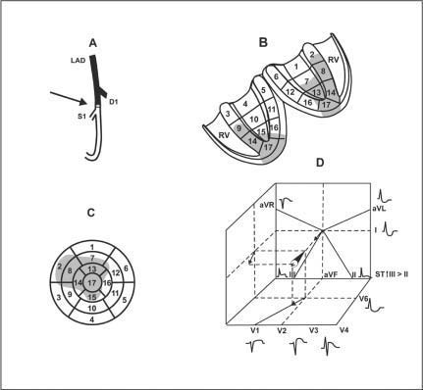
Occlusion proximal to s1 but distal to d1

Slide 45
Rarely occurs - <5% of the STEMI
Area at risk lead to an anteroseptal infarction.
Area at risk is more extensive when the D1 branch is quite small and the D2 branch is large
Usually more septal and anterior than lateral involvement
Usually seg 1 and part of seg 7 are spared because they are supplied by D1

Slide 46
Injury vector – anteriorly, to the right and sometimes downward
ST-segment elevation from V1 to V4 and isoelectric or elevated ST-segment in the inferior leads III > II
ST-segment depression is seen in V6 and aVL, and sometimes an ST-segment elevation in aVR

Slide 48
Lad occlusion involving diagonal branches but not septal branches or selective occlusion of d1

Slide 49
Area at risk – mid-low anterior wall and part of mid and often low-lateral wall
Basal lateral wall is not involved – perfused by LCX
Injury vector – upward, left and forward
ST elevation in I, aVL and V2-3 to V5-6
ST depression in II, III and aVF (III>II)

Slide 50
ST depression in V2−3 seen in multiple-vessel occlusion (D1 + LCX or RCA)
ST elevation in acute phase in aVL or QS in chronic phase without Q in V5−6 - involvement of the middle part of the anterior and lateral walls perfused by D1
-Not by the involvement of the high-lateral wall that is perfused by LCX

Slide 51
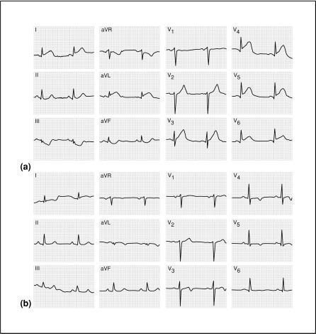

Slide 52
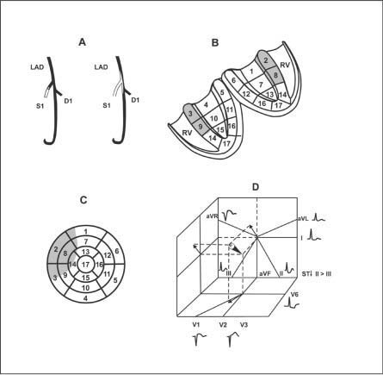
Lad occlusion involving septal branches but not diagonal branches or rarely selective occlusion of s1

Slide 53
Area at risk – septal wall with extension toward anterior wall
Injury vector – anteriorly, upward and to the right
ST elevation in V1, V2 and aVR
ST depression in II, III, aVF (II>III) and V6
Lack of ST elevation in aVL

Slide 55
Inferolateral zone : rca or lcx occlusion
a. RCA occlusion proximal to RV branches
b. RCA occlusion distal to main arterial supply to RV br
c. Occlusion of very dominant RCA
d. LCX occlusion proximal to first OM br
e. Occlusion of OM1
f. Occlusion of very dominant LCX

Slide 56
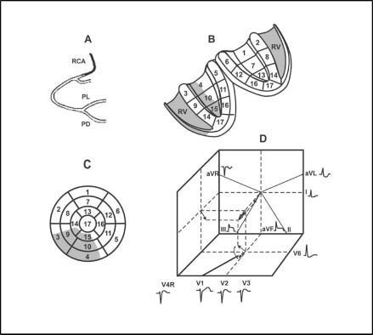
Rca occlusion proximal to rv branches

Slide 57
Area at risk – inferior wall, inferior part of septal wall and RV
Injury vector – downward, posteriorly and to the right
ST elevation in II, III and aVF (III>II) and V3R and V4R
ST depression in V6, I, and aVL (aVL>I)
V4R useful during the hyperacute phase to detect occlusion of the RCA proximal to the RV branch
V1 equally useful

Slide 58
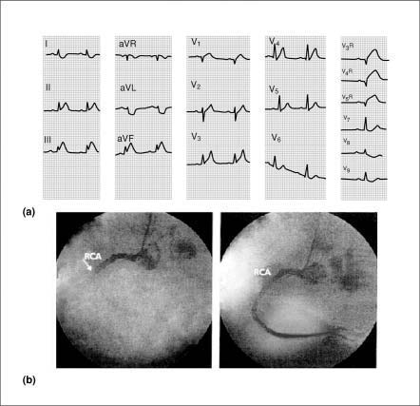

Slide 59
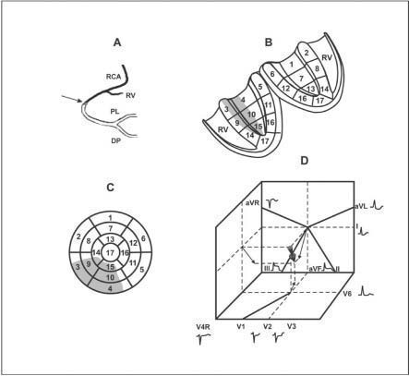
Rca occlusion distal to rv branch

Slide 60
Area at risk – inferolateral zone similar to occlusion proximal to RV br
Never evolve toward RV infarction
Injury vector – downward, to the right and posteriorly
LV involvement greater
More ST-segment elevation in II, III, and VF(III > II) than ST-segment depression in V1−3
ST-segment depression V6, I, and even more in aVL

Slide 62
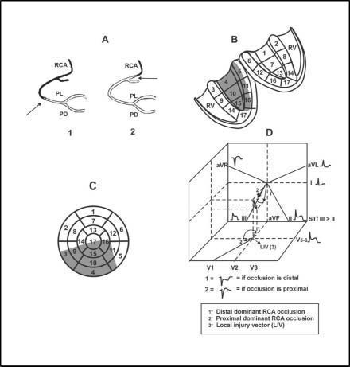
Occlusion of very dominant rca

Slide 63
Area at risk – posterior septum, the inferior wall, and even the apex if the LAD is short, and a portion of the posterior and lower part of the lateral wall
Injury vector – downward and posteriorly and to the right
ST isoelectric or slight elevation in V1and sometimes also elevated in V2-4
Occlusion distal to RV br – ST depression in V1-V3 and the ratio ↑ ST in II, III, VF/ ↓ ST in V1−3 is greater than 1

Slide 64
When the RCA is very dominant, ST-segment elevation ≥2 mm is usually seen in V5−6 (local injury vector)
ST depression in aVL and I
Subacute and chronic phases - involvement of both lateral and inferior walls - Q wave in inferior leads and the RS morphology in V1

Slide 65
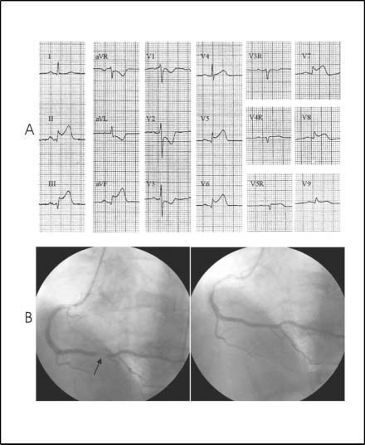

Slide 66
Lcx occlusion proximal to om1

Slide 67
Area at risk – majority of lateral wall and also inferior wall, esp. inferobasal seg.
Injury vector – leftward and more posteriorly than downward
ST elevation in II greater than or equal to III
ST-segment depression in V1−3 is of a higher voltage than the ST elevation in II, III, and aVF

Slide 69
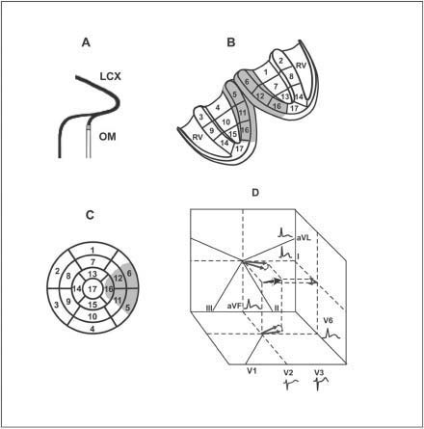
Occlusion of om1

Slide 70
Area at risk – great portion of anterior and also posterior part of posterior wall
Injury vector – left and somewhat posteriorly and upward or downward
Slight ST elevation usually seen in the so-called lateral wall leads (I, aVL, V5−6) and sometimes also in the inferior leads II and aVF
ST depression from V1 to V3
Subacute or chronic phase, “QR” or “R” morphology in “lateral leads” (I, aVL, and/or V5−6) may be present frequently with RS (R) in V1, but never QS in aVL

Slide 73
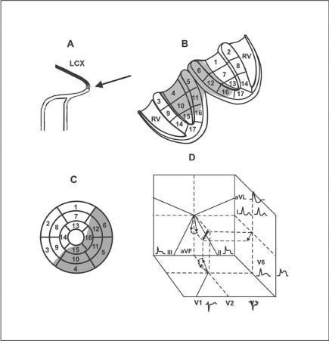
Occlusion of very dominant lcx

Slide 74
Area at risk – inferolateral zone – majority of lateral and inferior walls and some portion of posterior part of septum
Injury vector - FP between+60◦ and +90◦
Falls in the negative hemifield of aVL but is usually still in the positive hemifield of lead I

Slide 75
ST elevation in II, III, and VF is often smaller than the ST depression in V1−3
In the case that ST elevation in II, III, and VF is equal or superior to ST depression in V1−3, usually the ST elevation in II is greater than that in III and in lead I there is no ST depression (in contrast to proximal occlusion of a very dominant RCA)
ST elevation in V5−6 in the occlusion of a very dominant LCX is usually more evident than in a case of a very dominant RCA

Slide 76
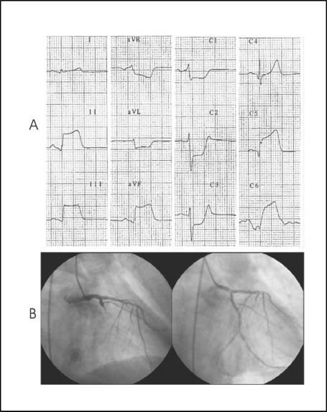

Slide 77
From the ecg pattern to occluded artery and the area at risk
A. ST elevation in precordial leads – anteroseptal zone
B. ST elevation in inferior leads – inferolateral leads

Slide 82
Most striking st elevation in lateral leads I, avl and v5-6
Seen in STEMI due to:
First-second diagonal occlusion
First-second OM occlusion
RI occlusion

Slide 83
D1 occlusion : significant ST elevation in V6, I and aVL than in inferior leads
ST elevation in precordial leads V2-3 to V5-6
Injury vector directed anteriorly
Chronic phase: QS morphology in aVL and I, no Q in V5-6

Slide 84
OM occlusion : slight elevation may be seen in both inferior and lateral leads
ST elevation in precordial leads is not present instead slight ST depression
Injury vector directed posteriorly
Chronic phase: QR morphology in V5-6, I, aVL or low-voltage R wave but no QS in aVL

Slide 85
Left main stem occlusion or three-vessel disease
ST elevation ≥ 0.5 mm in aVR with significant ST depression in many leads (≥8)
Left main trunk : large ST depression and no final positive T wave in V4-5
Proximal LAD occlusion: ST depression in many leads but with more ST depression in precordial than FP leads and with final positive T wave in V4-5

Slide 88
Quantification of the area at risk by the summation of ST segment elevations and depressions
Prognosis is worse when the summation of ST segment deviations is >15mm
- higher possibility of developing 1◦ VF
ST elevation > 8mm in 3 most compromised leads + hypotension : poor prognosis

Slide 89
Ischemia severity score
Sclarovsky-Birnbaum score
Grade I tall, peaked, symmetrical T waves
Grade II slope elevation of the ST segment
Grade III distortion of terminal QRS complex in the form of J point elevation > 50% of the preceding R or loss of normal S waves

Slide 90
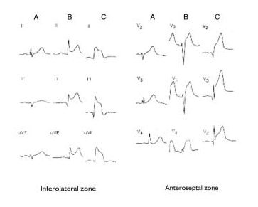

Slide 91
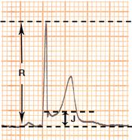
Grade III ischemia – ratio of J point/R wave > 0.5
Coronary occlusion very proximal and not much collateral circulation
involvement of Purkinje fibres – more resistant to ischemia
Area at risk is large and more severe
The need for urgent treatment

Slide 92
Ischemia due to multivessel occlusion
STEMI with ST elevation in II, III and aVF : ST depression beyond V2-3 with max changes in V4-5: occlusion of RCA plus LAD
ST elevation in V1-3 and ST depression in aVL, I, V4-6 suggests multivessel involvement

Slide 93
3. STEMI due to distal LAD occlusion – STE in precordial and inferior leads. This morphology may also be explained by occlusion of LAD plus RCA total occlusion with collaterals from LAD to the RCA
4.STE in I, aVL, V5-6 and STD in II,III, VF plus STD in V2-4 : occlusion of D1 + LCX or RCA

Slide 94
Limitations
Assessment of the site of occlusion of coronary vessel by ECG is most reliable in case of 1st MI
Impaired
Multivessel disease
Collateral circulation
When ventricular activation is prolonged as in :
LVH
Preexistent LBBB
Preexcitation
Paced rhythm

Slide 96
Ecg diagnosis of mi with lbbb

Slide 98
Ecg signs of mi in lbbb
ST elevations in lateral leads or ST seg depressions or deep T wave inversions in leads V1-V3 and STE > 0.5mV in leads with QS or rS waves : acute ischemia
QR in I, V5 or V6 or in II, III and aVF with LBBB : underlying MI
Notching of ascending part of a wide S wave in the midprecordial leads or ascending limb of a wide R wave in lead I, aVL, V5 or V6 : chronic MI

Slide 100
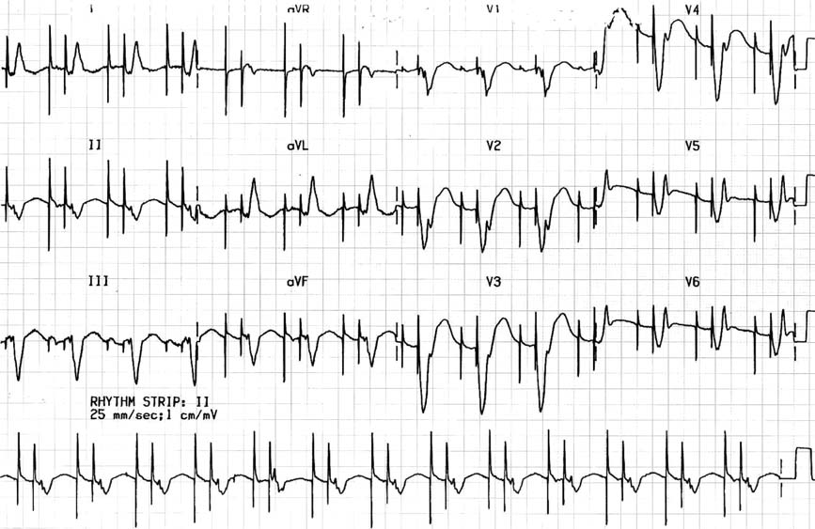
Ecg diagnosis of mi during cardiac pacing
Anterior myocardial infarction – St-qR pattern

Slide 101
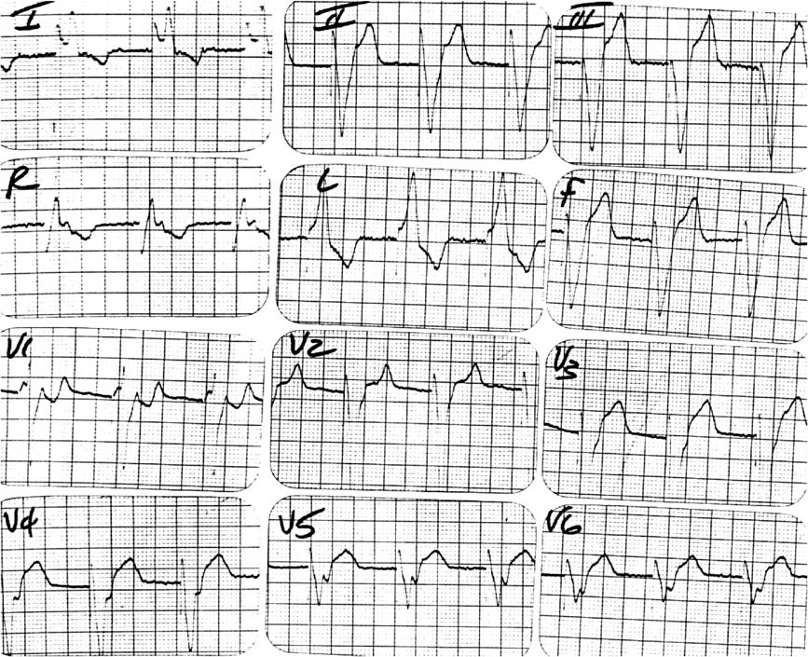
Late notching of the ascending s wave – Cabrera’s sign

Slide 102
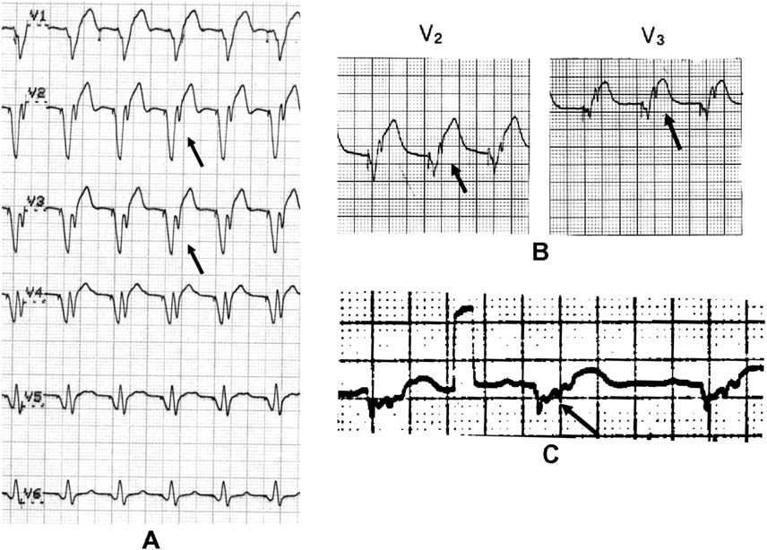

Slide 103
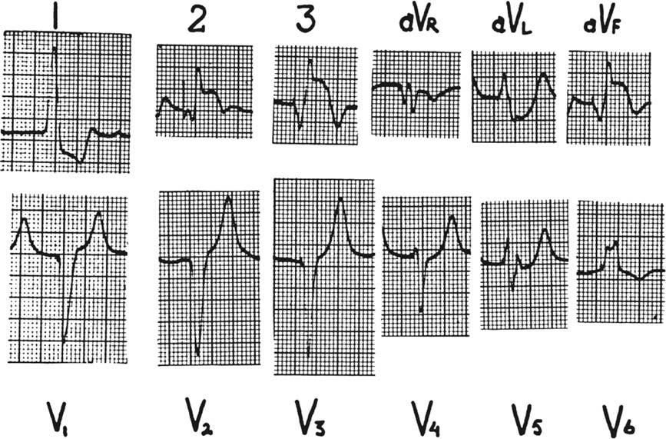

Slide 104
Acute myocardial infarction
Discordant ST elevation ≥5 mm – severe coronary disease – sensitivity 53% and specificity 88%
ST depression ≥1 mm in V1, V2, and V3 – sensitivity 29% and specificity 82%
ST elevation ≥1 mm in leads with concordant QRS

Slide 105
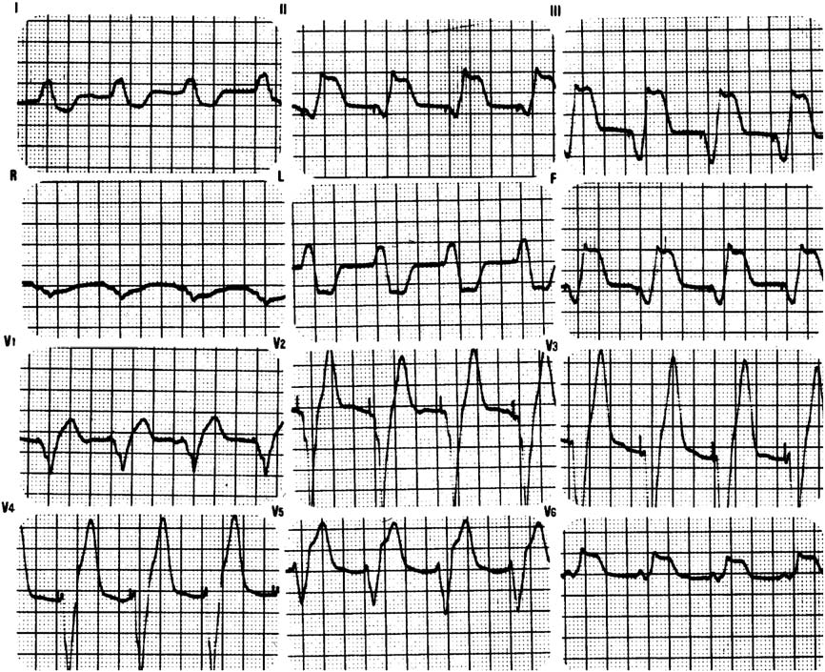

Slide 106
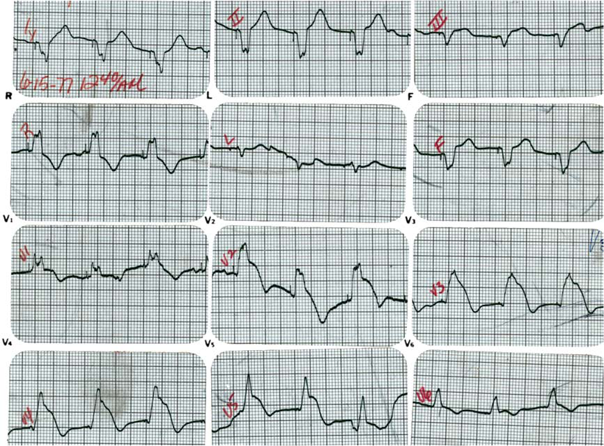

Slide 107
conclusions

Slide 111
Occlusion of d1 – south african flag sign

Slide 114
Thank you!

